Slide 1

Hello Class!
I Have a Cold

Slide 2
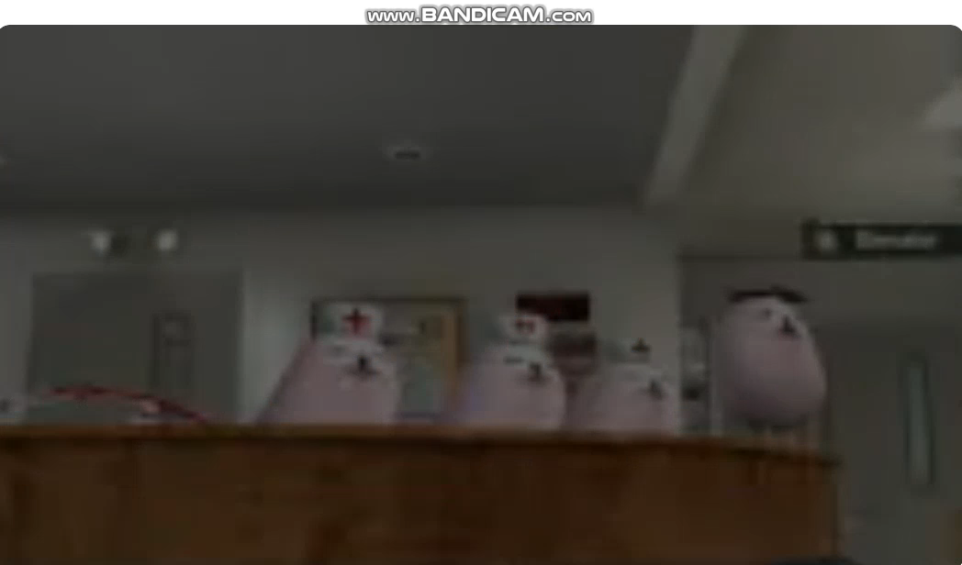
Notes:
This video is created by Zamsire and can be found on Youtube, Instagram or tiktok!
The videos are so cute and my previous students loved egg dog ~

Slide 3
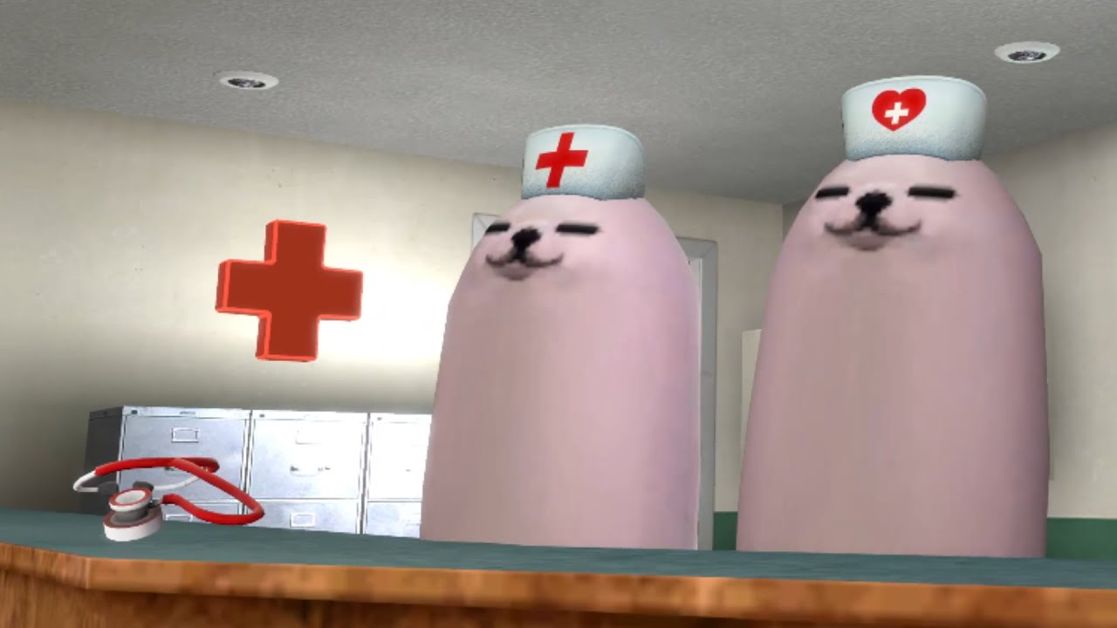
Egg Dog Hospital
Notes:
Assets Used:
Blur Hospital background: freepik.com
Eggdog Video and PNGs – Zamsire
Doctor Eggdog: HERE

Slide 4

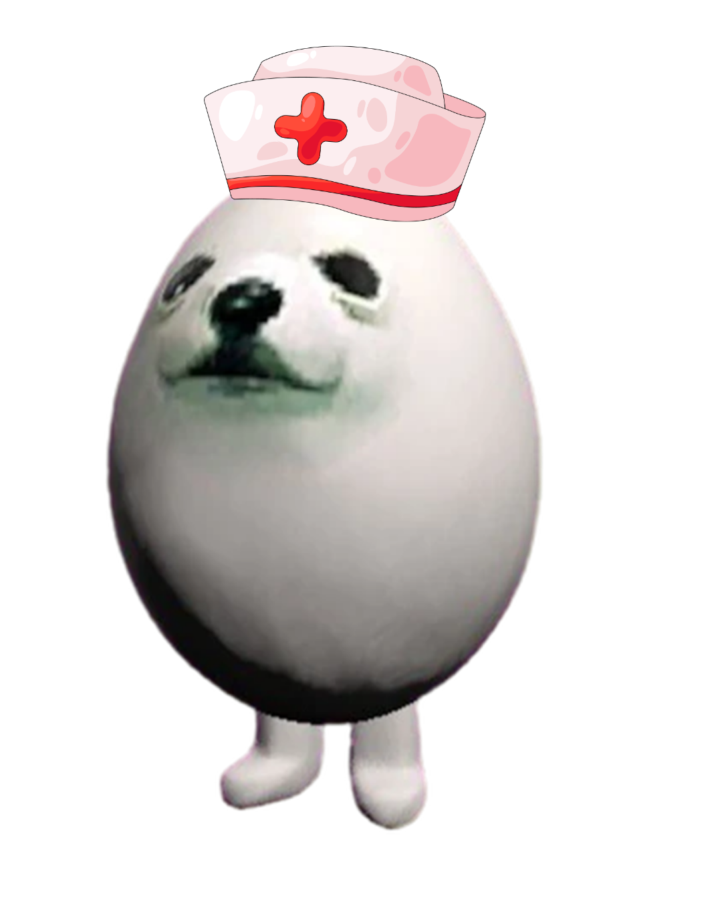
Welcome to Eggdog Hospital!
We have a lot of medicine !
Oh, hello!
Notes:
Assets Used:
Blur Hospital background: freepik.com
Eggdog Video and PNGs – Zamsire
Doctor Eggdog: HERE

Slide 5
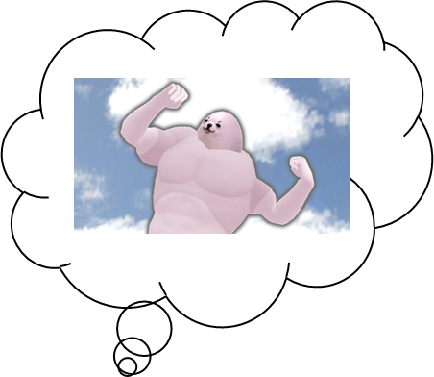



!!!!
?
Notes:
Assets Used:
Blur Hospital background: freepik.com
Eggdog Video and PNGs – Zamsire
Doctor Eggdog: HERE

Slide 6
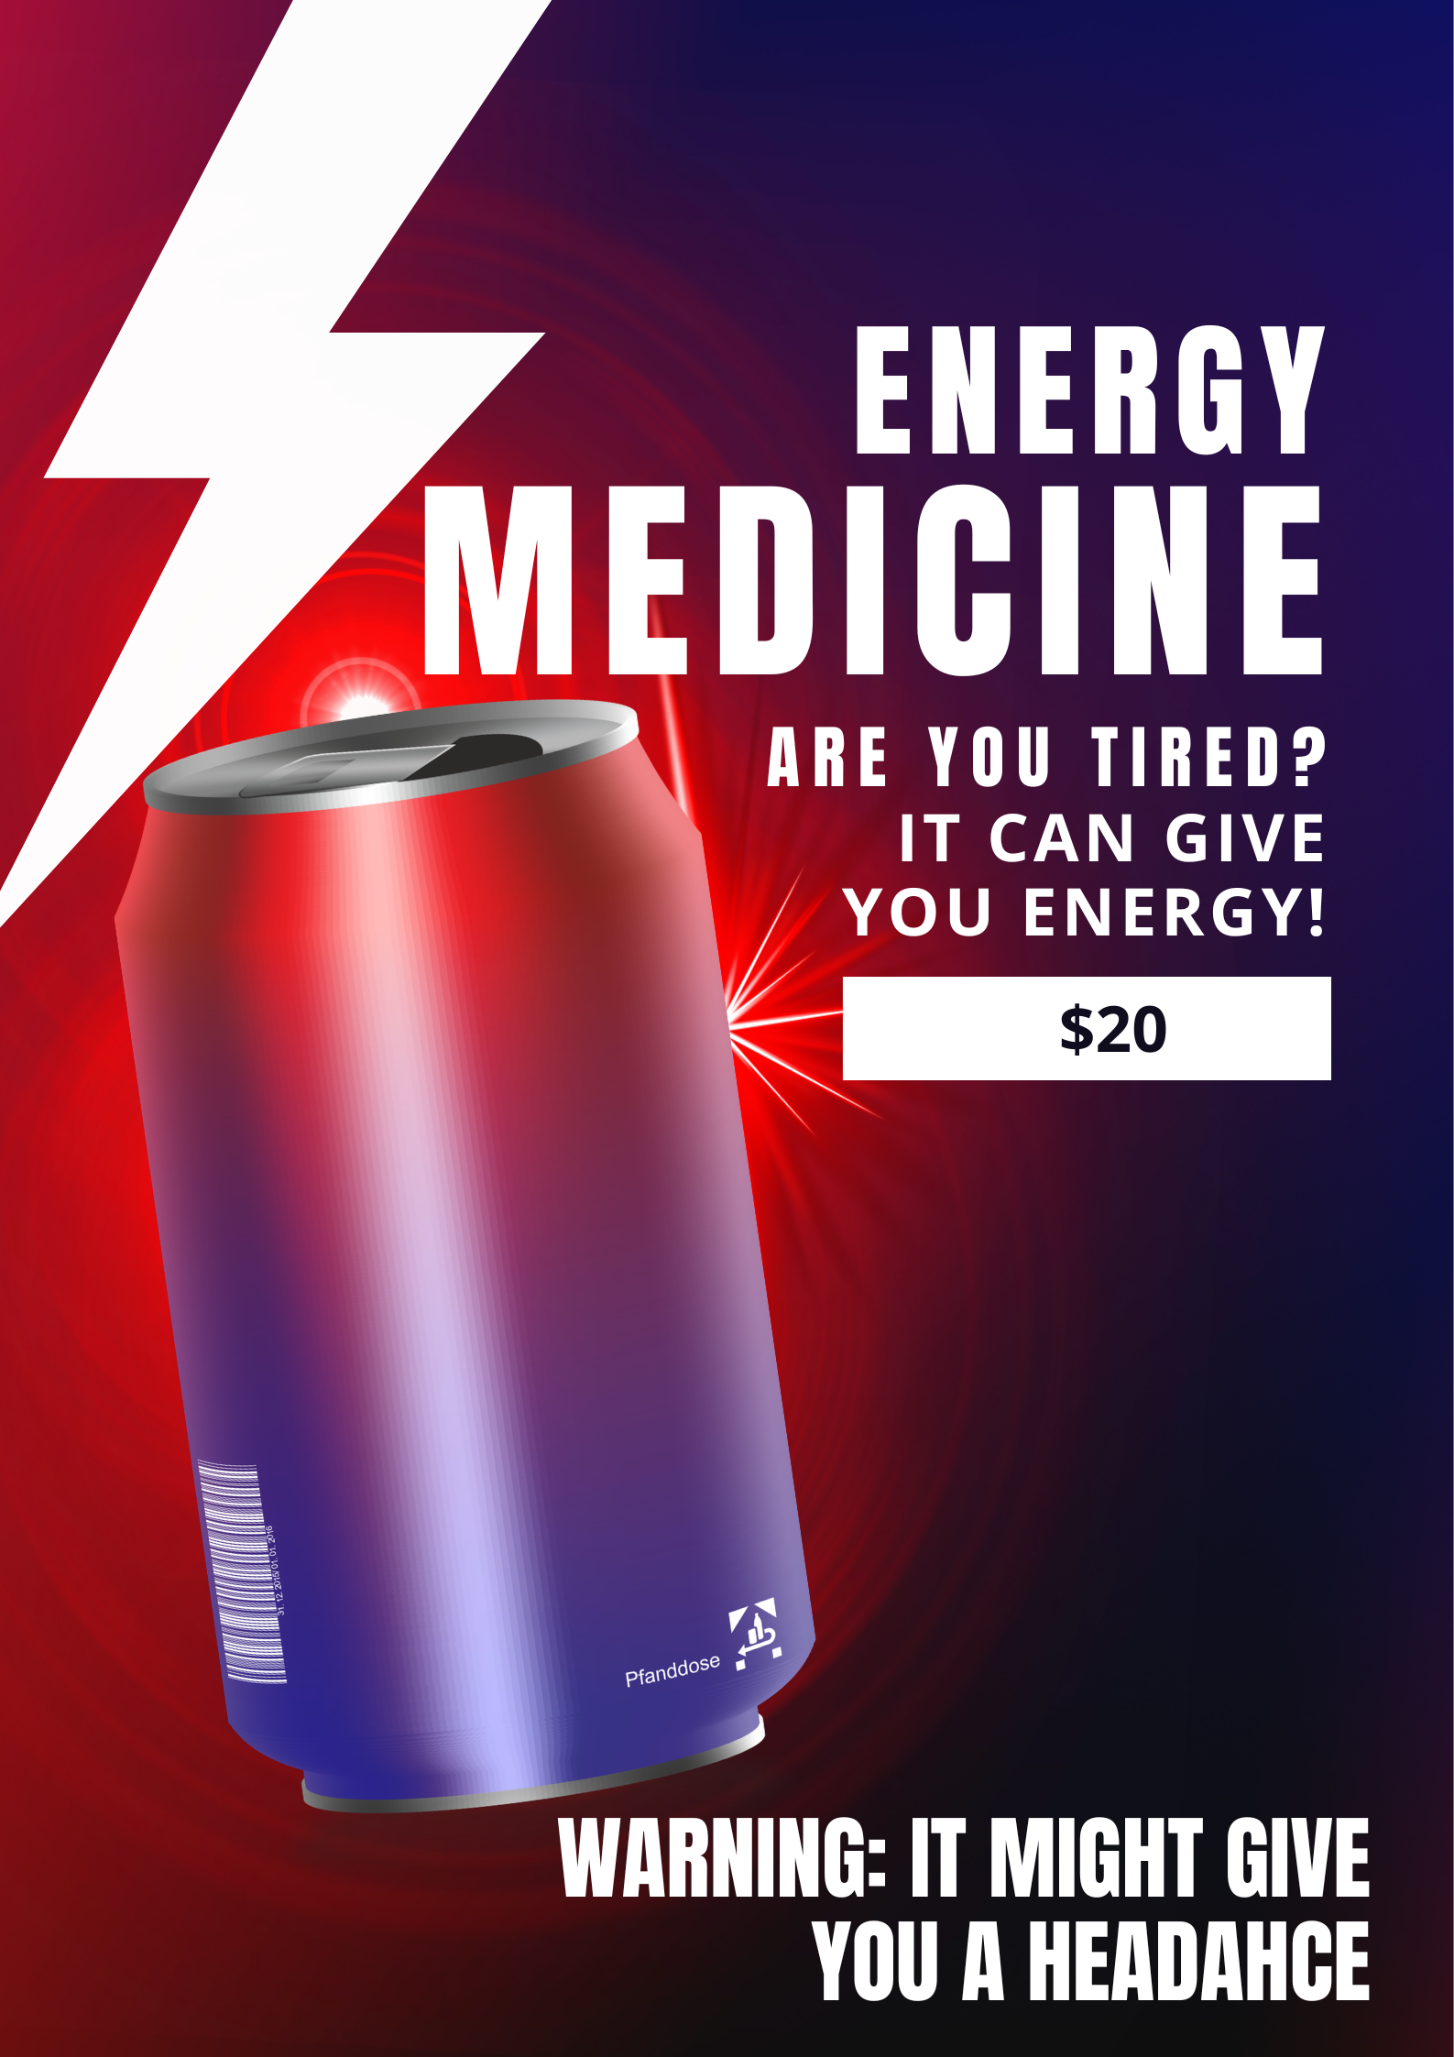
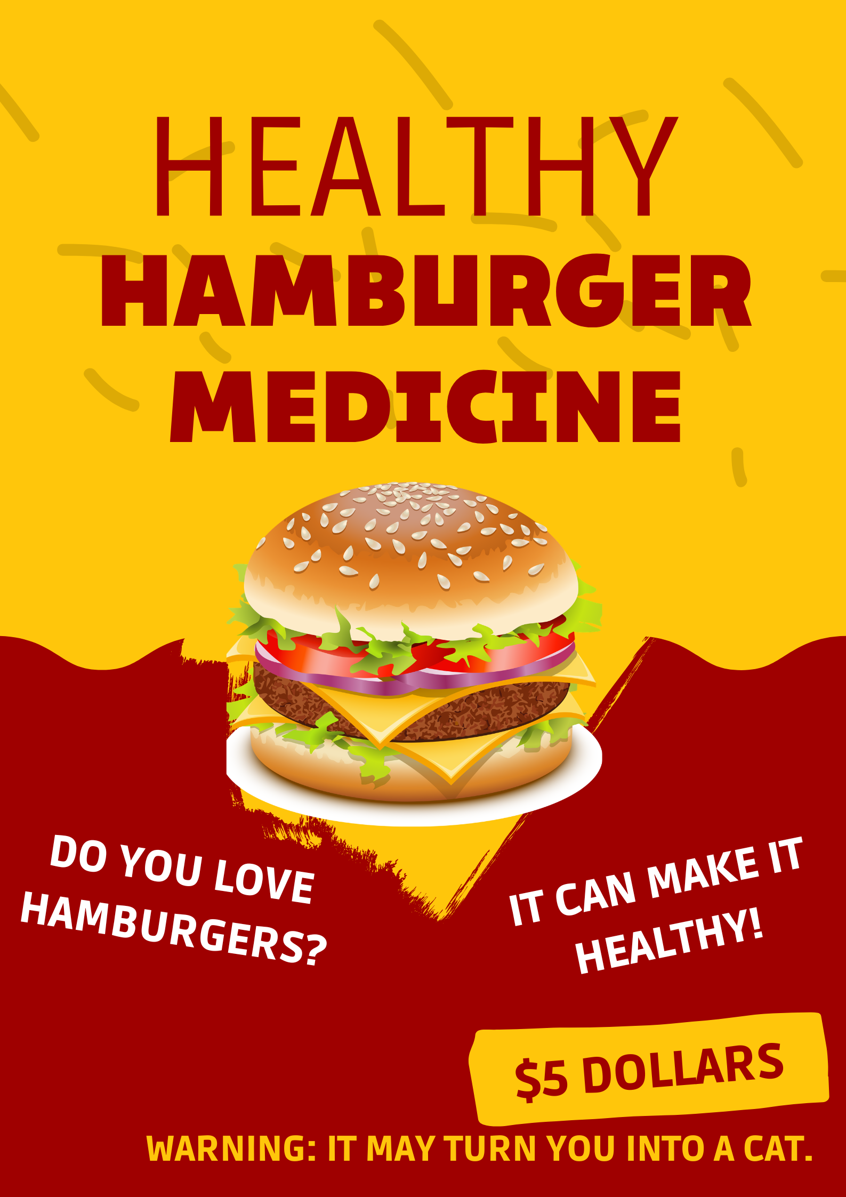
Notes:
Assets Used:
Blur Hospital background: freepik.com
Eggdog Video and PNGs – Zamsire
Doctor Eggdog: HERE

Slide 7
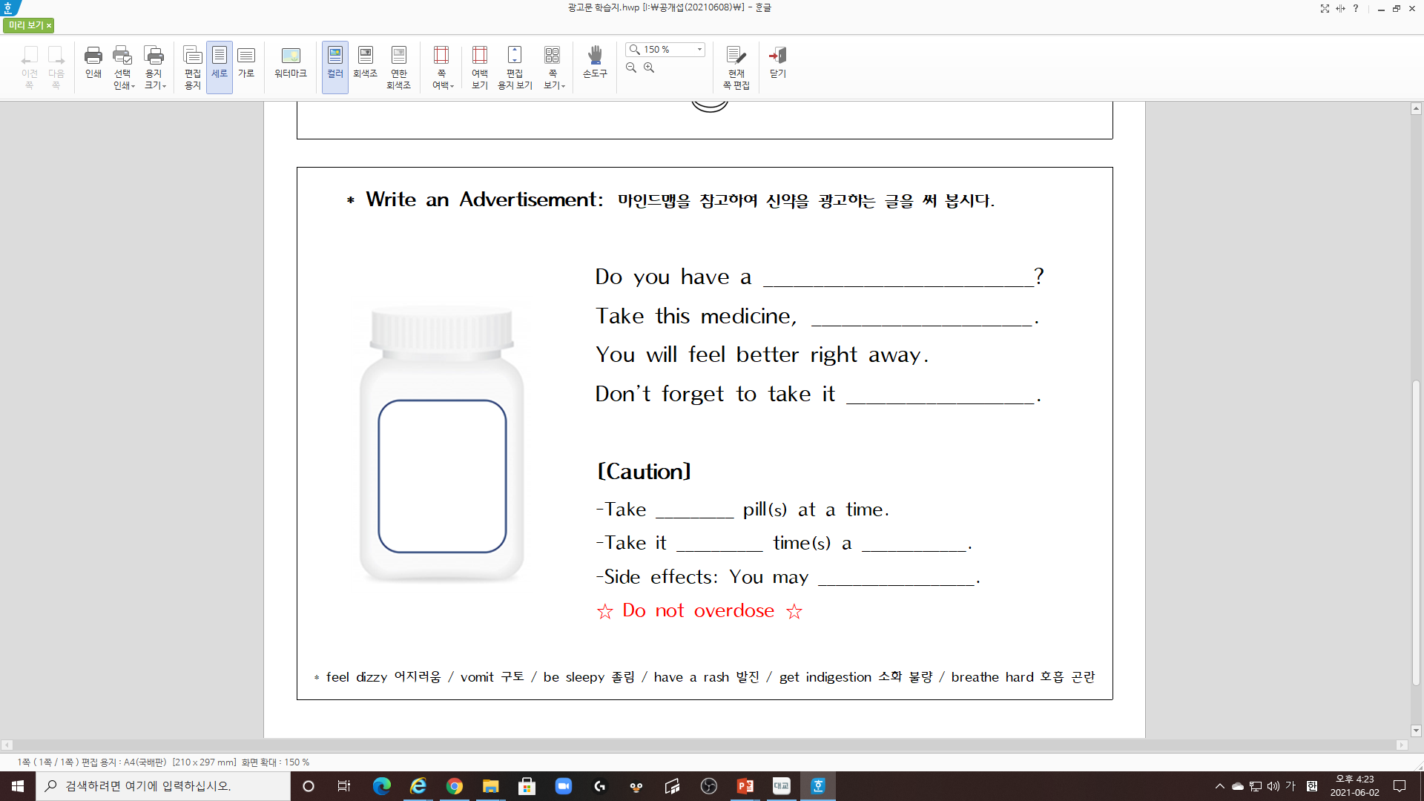

Notes:
Assets Used:
Blur Hospital background: freepik.com
Eggdog Video and PNGs – Zamsire
Doctor Eggdog: HERE

Slide 8
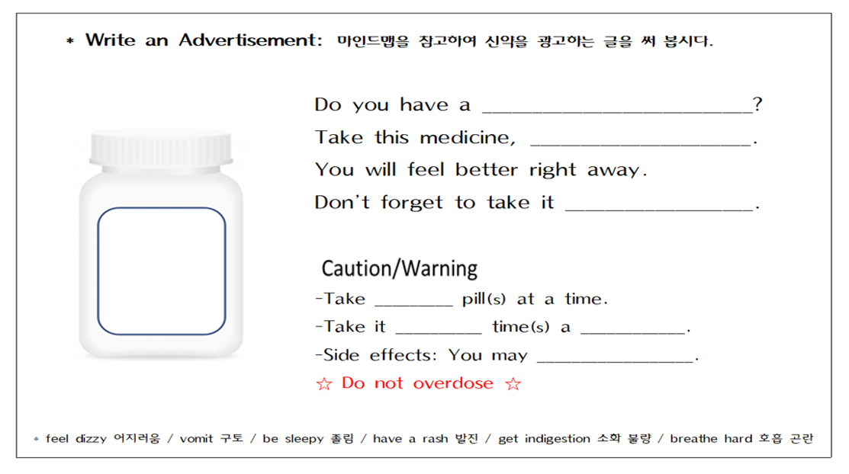
Notes:
Assets Used:
Blur Hospital background: freepik.com
Eggdog Video and PNGs – Zamsire
Doctor Eggdog: HERE

Slide 9
How to Take(복용법)
-before/after meals 식전/식후
-1(2) pill(s) at a time 한 번에 1(2)알
-3 times a day 하루에 3번
-Do not overdose 과다 복용 금지

Slide 10
Side Effects(부작용)
-feel dizzy 어지러움
-vomit 구토
-be sleepy 졸림
-have a rash 발진
-get indigestion 소화 불량
-breathe hard 호흡 곤란

Slide 11
How to Use Chromebook
-키워드를 정확하게 입력
-이미지 검색 활용: 그림을 보면서 아이디어를 얻는 정도 활용
-번역기 활용 (ChatGPT/Gemini, Papago / Google Translate):
영어문장이 맞는지 AI에 물어보거나 역번역 해 보기
-모둠원과 정보 공유하며 검색

Slide 12
Notes:
Assets Used:
Blur Hospital background: freepik.com
Eggdog Video and PNGs – Zamsire
Doctor Eggdog: HERE

Slide 13
Good Job!

