Slide 1
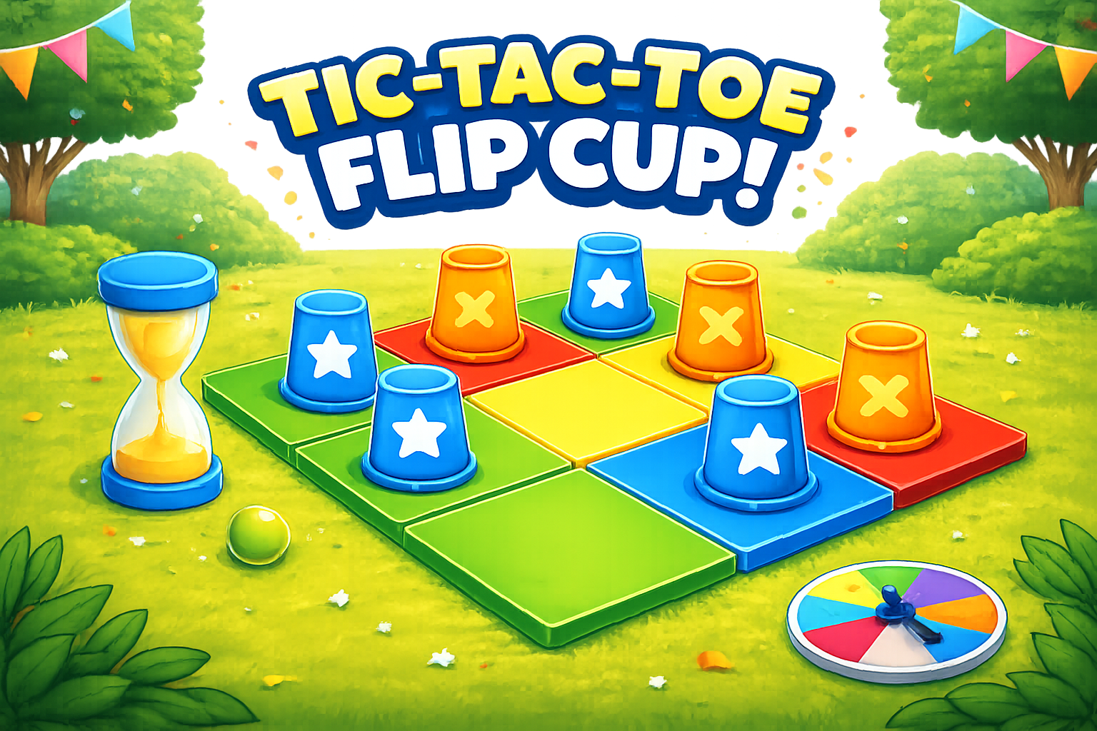
Notes:
Tic Tac Toe Flip Game – How to Play
Objective
Students race to flip their team’s cup. After a successful flip, the student says the word or sentence and places their cup on the Tic Tac Toe board.
Setup
• Divide the class into two teams OR small groups
• Give each team colored cups or cups with team stickers
• Place the Tic Tac Toe board where everyone can see it
• Give one cup to each student
How to Play
Students take one cup in their team color
All students attempt to flip their cup
When a student flips successfully, they choose a square
The student says the word or sentence on the square
If correct, they place their cup on that square
Play continues until a team gets three in a row
Rules
• Students must flip successfully before placing
• Students must say the word/sentence correctly
• If incorrect, the cup is removed and play continues
• Students may only place one cup per turn
• Cups stay on the board once placed
Game Modes
Whole Class Mode
Split the class into two teams. All students play at the same time.
Small Group Mode
Divide students into groups of 4–6.
Each group gets one board and colored cups.
Students compete within their group.
Optional Variations
• Require full sentence instead of one word
• Require spelling
• Require translation
• Teacher chooses the square instead of students

Slide 2

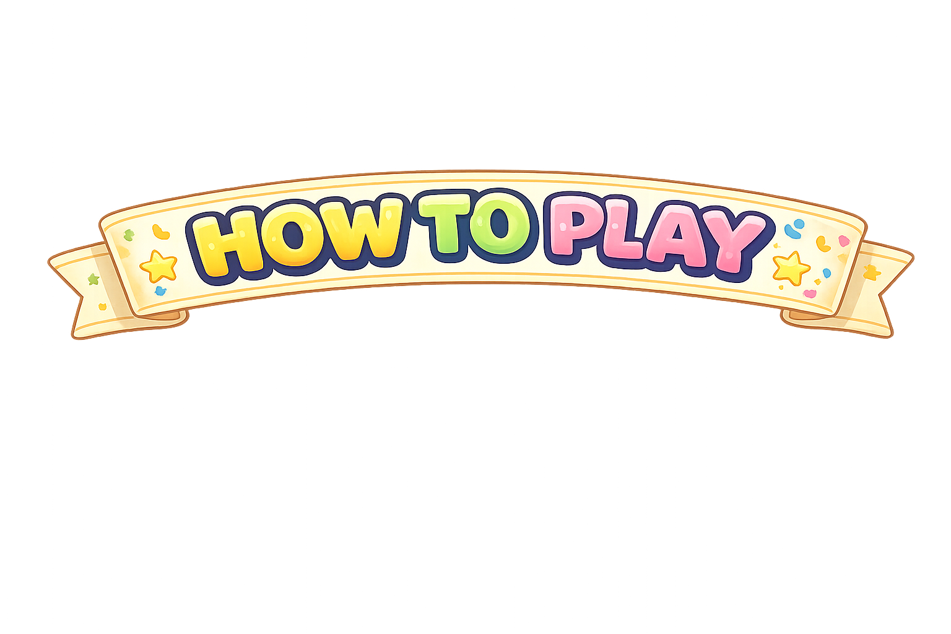

Take one cup that is your team color.
Flip your cup.
Notes:
How to Play
Take one cup in your team color
Flip your cup
When you flip it, choose a square
Say the word or sentence
Place your cup on the board
First team with 3 in a row wins!
Rules
• Flip first
• Say it correctly
• One cup per student

Slide 3
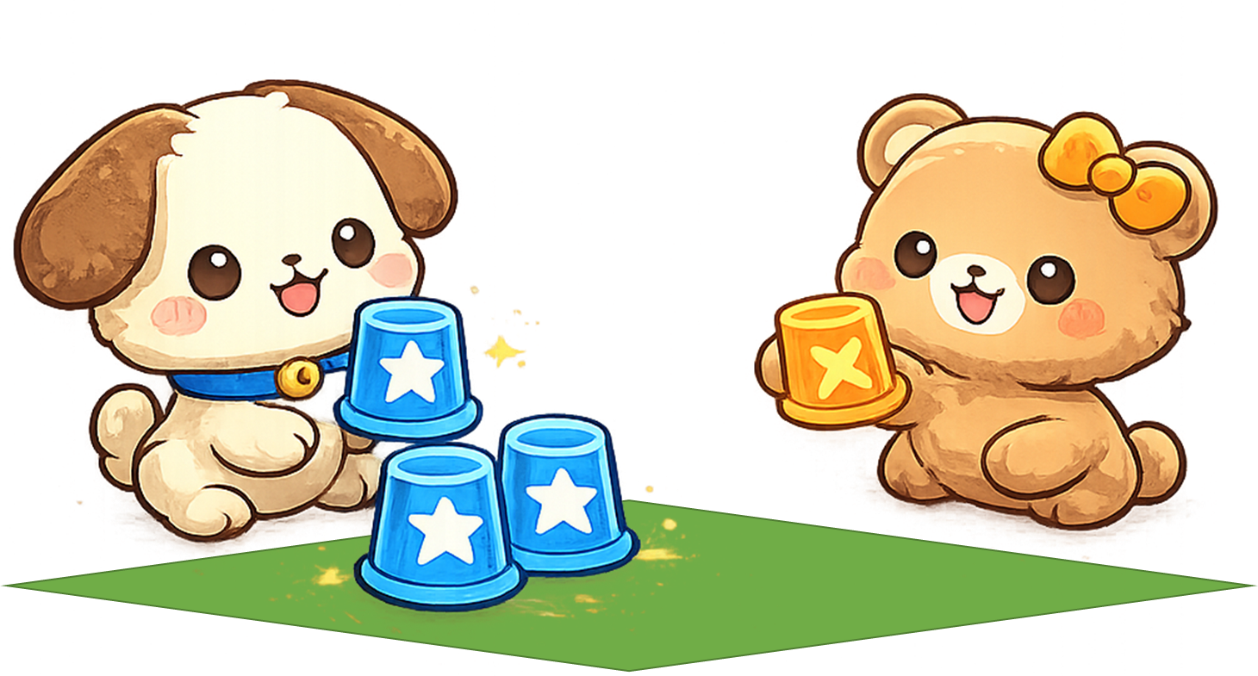
When you flip it, place your cup on the board!
Say the word or sentence!
No English = No Cup!
Word 1
Word 7
…
Word 1 | Word 2 | Word 3
Word 4 | Word 5 | Word 6
Word 7 | Word 8 | Word 9
Notes:
Tic Tac Toe Flip Game – How to Play
Objective
Students race to flip their team’s cup. After a successful flip, the student says the word or sentence and places their cup on the Tic Tac Toe board.
Setup
• Divide the class into two teams OR small groups
• Give each team colored cups or cups with team stickers
• Place the Tic Tac Toe board where everyone can see it
• Give one cup to each student
How to Play
Students take one cup in their team color
All students attempt to flip their cup
When a student flips successfully, they choose a square
The student says the word or sentence on the square
If correct, they place their cup on that square
Play continues until a team gets three in a row
Rules
• Students must flip successfully before placing
• Students must say the word/sentence correctly
• If incorrect, the cup is removed and play continues
• Students may only place one cup per turn
• Cups stay on the board once placed
Game Modes
Whole Class Mode
Split the class into two teams. All students play at the same time.
Small Group Mode
Divide students into groups of 4–6.
Each group gets one board and colored cups.
Students compete within their group.
Optional Variations
• Require full sentence instead of one word
• Require spelling
• Require translation
• Teacher chooses the square instead of students

Slide 4

First team with 3 in a row wins!
+1
Notes:
Tic Tac Toe Flip Game – How to Play
Objective
Students race to flip their team’s cup. After a successful flip, the student says the word or sentence and places their cup on the Tic Tac Toe board.
Setup
• Divide the class into two teams OR small groups
• Give each team colored cups or cups with team stickers
• Place the Tic Tac Toe board where everyone can see it
• Give one cup to each student
How to Play
Students take one cup in their team color
All students attempt to flip their cup
When a student flips successfully, they choose a square
The student says the word or sentence on the square
If correct, they place their cup on that square
Play continues until a team gets three in a row
Rules
• Students must flip successfully before placing
• Students must say the word/sentence correctly
• If incorrect, the cup is removed and play continues
• Students may only place one cup per turn
• Cups stay on the board once placed
Game Modes
Whole Class Mode
Split the class into two teams. All students play at the same time.
Small Group Mode
Divide students into groups of 4–6.
Each group gets one board and colored cups.
Students compete within their group.
Optional Variations
• Require full sentence instead of one word
• Require spelling
• Require translation
• Teacher chooses the square instead of students

Slide 5
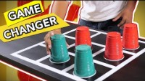
Let’s Watch:
Notes:
This slide can be used if students have a hard time understanding the instructions.
https://www.youtube.com/watch?v=k9UGQhz3vPg

Slide 6
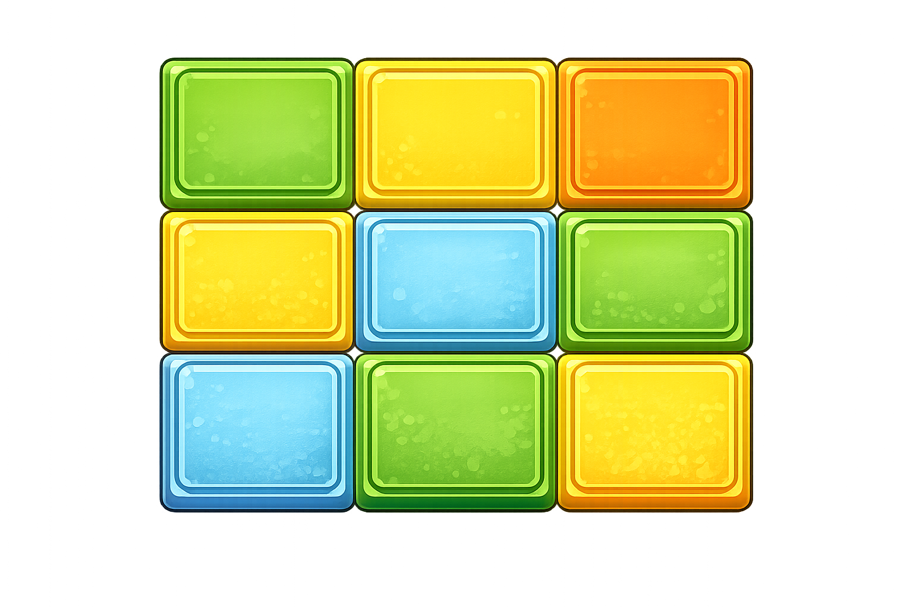


Notes:
Click the squares to select the image. Right click to open the pop-up menu. Select change image to swap the image.
How to play:
Click the colored circle to add the team’s cup. If mistakes are made – click the cup to remove it.

Slide 7
Sentence 1 | Sentence 2 | Sentence 3
Sentence 6 | Sentence 5 | Sentence 4
Sentence 7 | Sentence 8 | Sentence 9
Notes:
In the home tab, click replace. Use sentence 1 – sentence 9 to replace with key words or key expressions.
How to play:
Click the colored circle to add the team’s cup. If mistakes are made – click the cup to remove it.

